Slide 1


IBM DATA SCIENCE CAPSTONE PROJECT PRESENTATION
Nana Abena Kumi
November 2024

Slide 2
Outline
Executive Summary
Introduction
Methodology
Results
Conclusion
Appendix

Slide 3

Executive Summary
Summary of methodologies
Data Collection via API & Web scraping
Data Wrangling
Exploratory Data Analysis (EDA) using SQL
EDA with Visualization
Interactive maps using Folium
Dashboards with Ploty Dash
Using Predictive Analysis
Summary of all results
Results of Exploratory Data Analysis
Dashboards and Interactive Maps
Results of predictive Analytics Performed

Slide 4

Introduction
Project background and context
SpaceX is a space technology company that is known for its role in reducing the cost of space travel and making space more accessible. SpaceX advertises Falcon 9 rocket launches on its website with a cost of 62 million dollars; while other providers cost upward of 165 million dollars each. The aim of the project is to predict if the first stage will land successfully and determine the cost of the launch using public data and machine learning models. The results of this project may be useful for an alternate company.
Problem Statement
Most space travel providers rocket launches cost upwards of $165m, about 100 million dollars less that what SpaceX is providing. How? This is because the company can reuse the first stage.
If we can determine which factors contribute to a successful landing and how they contribute to it, we will be able to replicate similar cost savings for an alternate company, say SpaceY.

Slide 5

Section 1
METHODOLOGY

Slide 6
Methodology
Executive Summary
Data collection methodology:
Data collected using SpaceX Rest API
Web scraping from Wikipedia (https://en.wikipedia.org/wiki/List_of_Falcon_9_and_Falcon_Heavy_launches)
Perform data wrangling
Handling missing values
Using One Hot Encoding to classify the landing outcomes
Perform exploratory data analysis (EDA) using visualization and SQL
Perform interactive visual analytics using Folium and Plotly Dash
Perform predictive analysis using classification models
How to build, tune, evaluate classification models

Slide 7
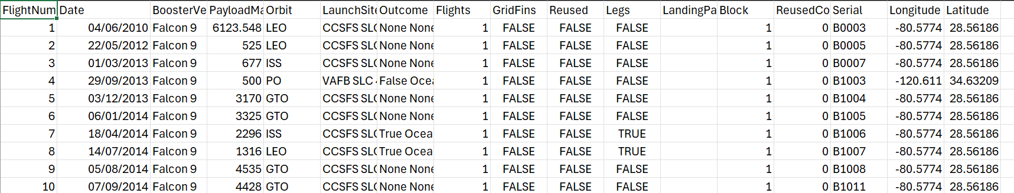
Data Collection – SpaceX API
Data collection steps
Requested launch data from SpaceX API
Decoded the response as a Json using .json() and into a pandas data frame using .json_normalize()
Requesting additional information on the launches from SpaceX API by applying specified functions
Filtering the dataframe for only Falcon 9 launches
Construct a dataset from the data combined into a dictionary
Dealing with PayloadMass missing values by replacing them with the mean values
Exporting to a csv file
Extract of output file below
Github Link : Data Collection
https://github.com/Nana-ty/ML-Project/blob/main/dataset_part_1.csv

Slide 8




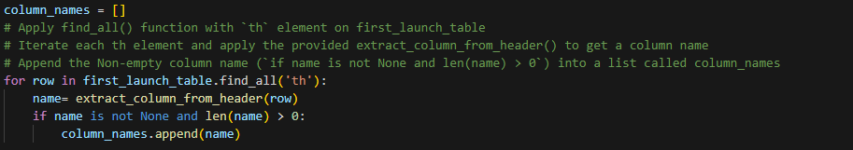

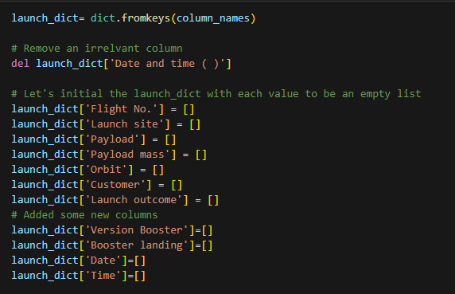

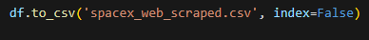
Data Collection – Web Scraping
Get response from Falcon9 launch HTM by performing an HTTP Get
Create dictionary and add data to the keys
Create Beautiful Soup Object
Extract all columns and extract column names
Create dataframe and export file
Webscraping Link

Slide 9

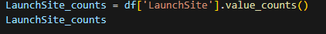
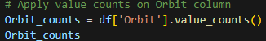
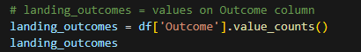


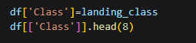
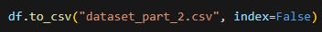
Data Wrangling
Using the dataset from the previous step (webscraping), pandas is used to perform data analysis
Using the .value_counts() method to:
1. Determine the number of launches per launch site
2. Calculate the number and occurrence of each orbit and
3. Calculate the number & occurrence of mission outcome per orbit type
Create landing outcome label from the outcome column. An outcome is assigned 0, if in the set bad_outcome, otherwise it’s a 1 to a list called landing_class
Create a column called Class that contains the values from landing_class and export to csv
Data Wrangling Link
dataset_part_2.csv

Slide 10



EDA with Data Visualization
Three types of charts were used for plotted for the data visualization section
Scatter plots were used to visualise the relationships between:
Payload Mass and Flight Number
Launch Site and Flight Number
Payload Mass and Launch Site
Orbit and Flight Number
The scatter plot was used to visualise the relationship/correlation between two variables
Bar Charts was used to visualise the success rate of each orbit.
Average Class and Orbit
The bar chart was used to compare the numerical value (class) to a categorical value (orbit)
Line Charts was used to visualise the launch success yearly trend.
Class and year
The line chart was used to determine trends over time
Data Visualization
dataset_part_3.csv

Slide 11
EDA with SQL
SQL queries performed on the dataset were:
Display the names of the unique launch sites in the space mission
Display 5 record where launch sites begin with the string ‘KSC’
Display the total payload mass carried by boosters launched by NASA (CRS)
Display the average payload mass carried by booster version F9 v1.1
List the date where the successful landing outcome in drone ship was achieved
List the names of boosters which have success in ground pas and have payload mass greater than 4000 but less than 6000kg
List the total number/count of successful and failed mission outcomes
List the names of booster_versions which have carried the maximum payload mass
List the month names, successful (ground pad) landing outcomes, booster version and launch sites for the months in 2017
Rank the count of landing outcomes (such as Failure (drone ship) or Success (ground pad)) between 04/06/2010 and 20/03/2017 in descending order
Github SQL Link

Slide 12
Build an Interactive Map with Folium
The following steps were to visualize the launch site locations and find some geographical patterns.
TASK 1 : Mark all launch sites on a map.
Create a folium Map object with NASA Johnson Space Center to be the initial center location
Used folium.Circle and folium.Marker to add a highlighted circle and text label for each launch site
TASK 2 : Mark the success/fails launches for each site on the map
Added marker colors to the launch sites to indicate if the launch site was a success or failure
TASK 3 : Calculate the distances between a launch sites
Calculated the distance between the coastline point and the launch sites to its proximities
Used folium.PolyLine to display the line between the launch site and the coastline. For ex. We can see that launchsite CCAFS LC-40 is relatively close to a highway
Github Link

Slide 13
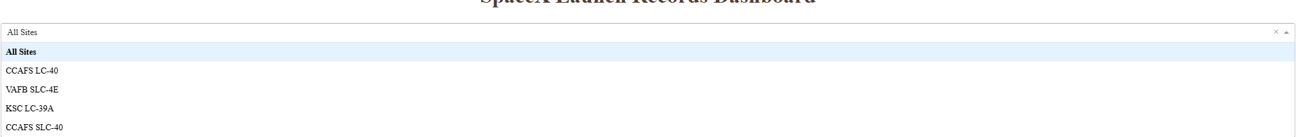
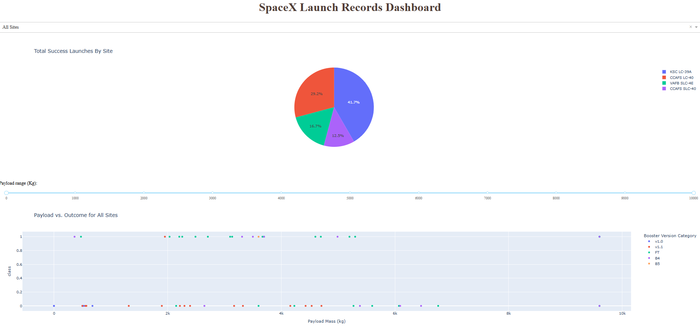
Build a Dashboard with Plotly Dash
Plots/Graphs & Interactions added include:
1. Pie chart (Success Pie Chart) to display/visualize successful launches:
At an overall level for all sites
Per each site showing the split between successful and failed launches. A dropdown option (interaction added) to give the user the option to toggle between all sites and a specified site.
2. Scatter Plot (Success-Payload Scatter Plot) to visualize & understand the relationship between the payload(kg) and the launch outcomes:
At an overall level for all sites
Per each site . A payload range slider (interaction) was added to adjust the chart by range of payload masses.
The chart can also be filtered by booster version category
spacex_dash_app github link

Slide 14
Predictive Analysis (Classification)
Data pre-processing:
1. Creating NumPy array for the ‘Class’ column.
2. Splitting the data into training and test sets
Explored multiple classification models including decision tree, KNN, SVM and logistic regression.
Determined the method that performs best.
Created a GridSearchCV object with cv =10 to find the best parameters
Applied the GridSearchCV on LogReg, Decision tree, KNN and SVM models
Calculated the accuracy of each of the models [using the method .score()]
Examined the confusion matrix for each of the models
Determined the method using jaccard_score and f1_score
GitHub URL : ML Prediction

Slide 15
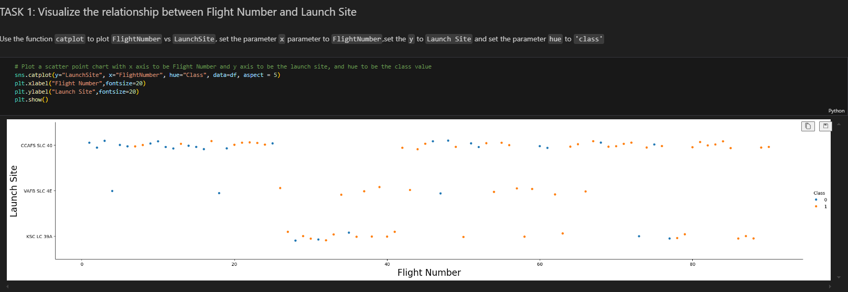
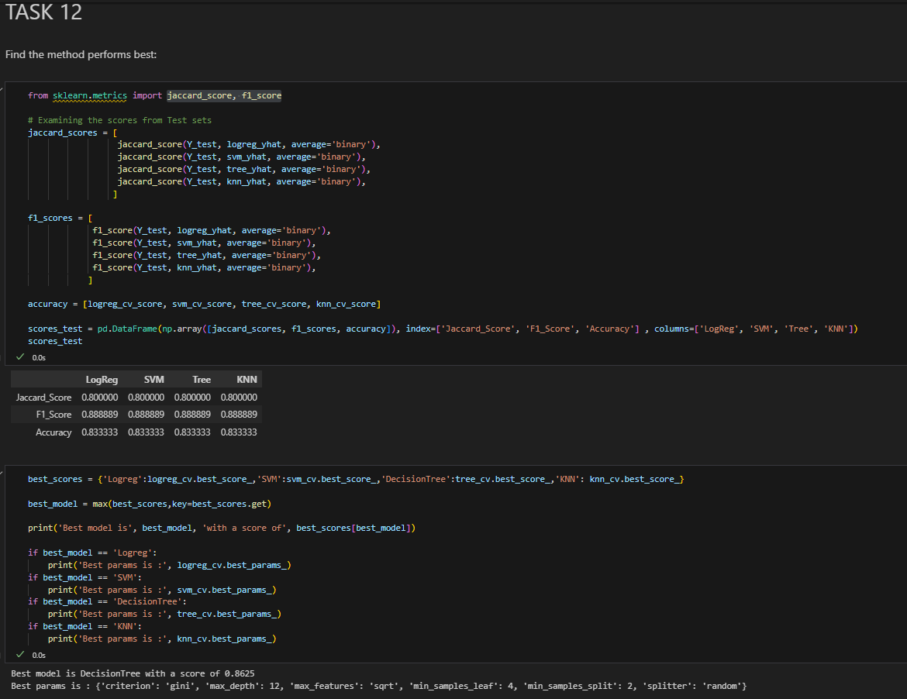
Results
Exploratory data analysis results
Interactive analytics demo in screenshots
Predictive analysis results
GitHub URL

Slide 16

Section 2
INSIGHTS DRAWN FROM EDA

Slide 17
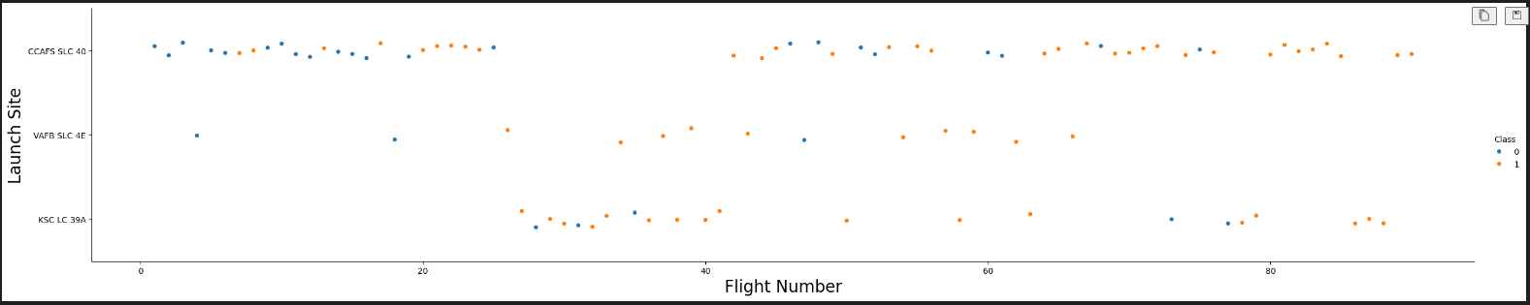
Flight Number vs. Launch Site
Explanation
From the plot, at the higher flight numbers there were more successful landings across all three launch sites.

Slide 18
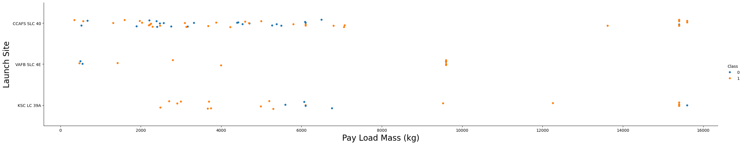
Payload vs. Launch Site
Explanation
Overall, it appears that the higher the payload mass the higher the success rate of landing
Particularly, over 8,000kg there were more successful landings
There is variability of success at CCAFS SLC 40 launch site during the lower payload masses.

Slide 19
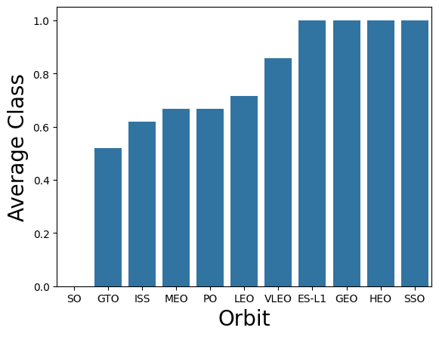
Success Rate vs. Orbit Type
Explanation
The orbits ES-L1, GEO, HEO and SSO had 100% success rates with other orbits with lower success rates.
Orbit SO had 0% success rate.

Slide 20
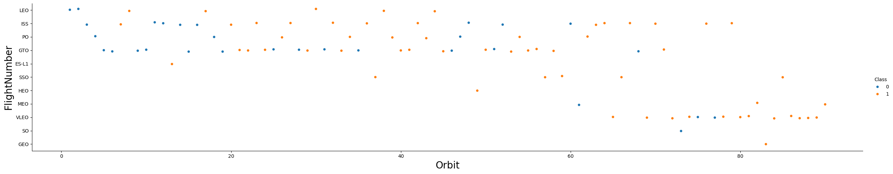
Flight Number vs. Orbit Type
Explanation
The success rates of launches increases over the flight numbers with VLEO and ISS having very high success rates
Launches to GTO, PO, ISS & LEO have mixed results at the earlier launches.
* Note: the x & y labels should be the other way round

Slide 21
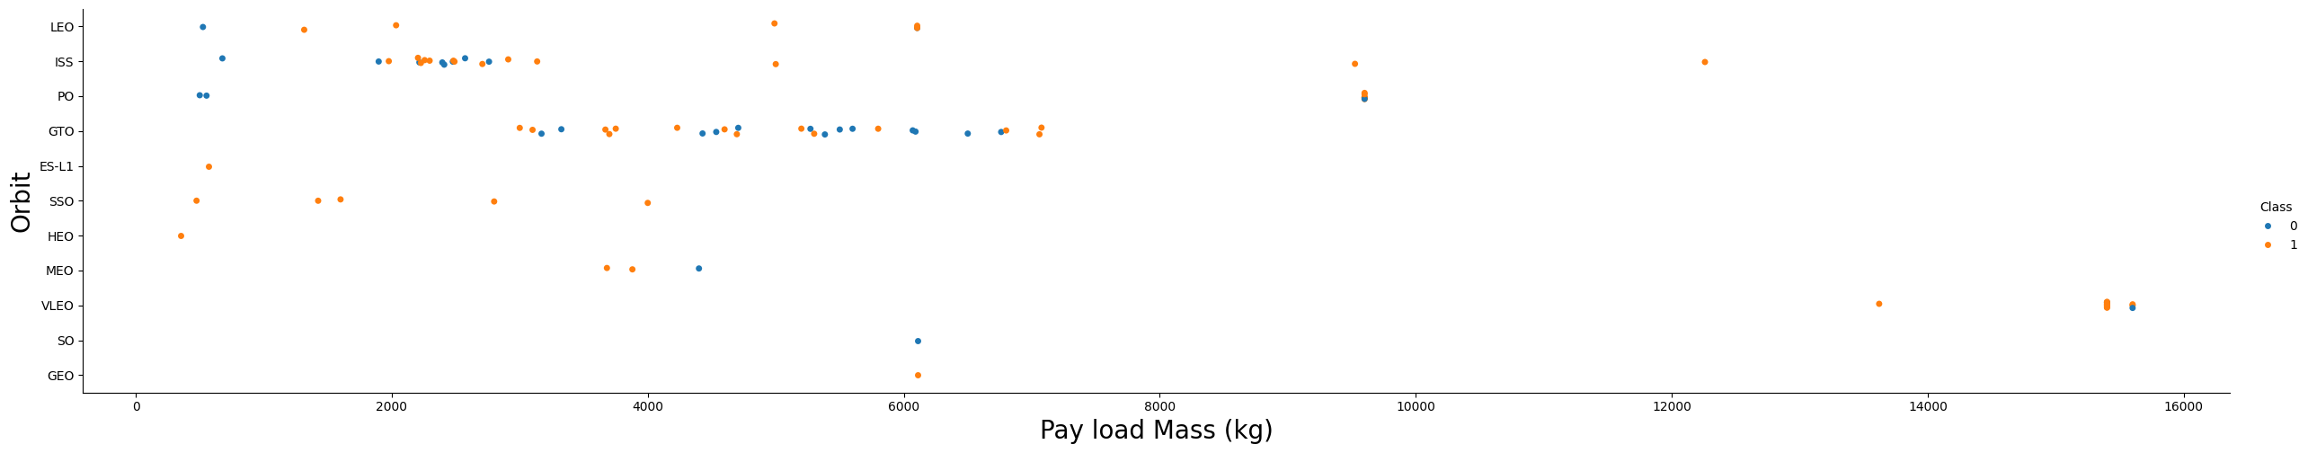
Pay Load Mass vs. Orbit Type
Explanation
The lighter pay loads have mixed results
There are fewer launches t heavier payloads, however more successful.

Slide 22
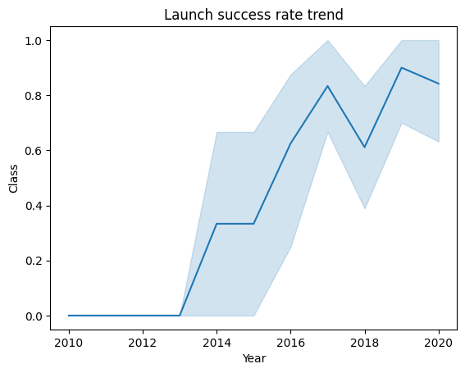
Launch Success Yearly Trend
Explanation
The success rate increased over time with a dip in 2018 and picked up in 2020

Slide 23
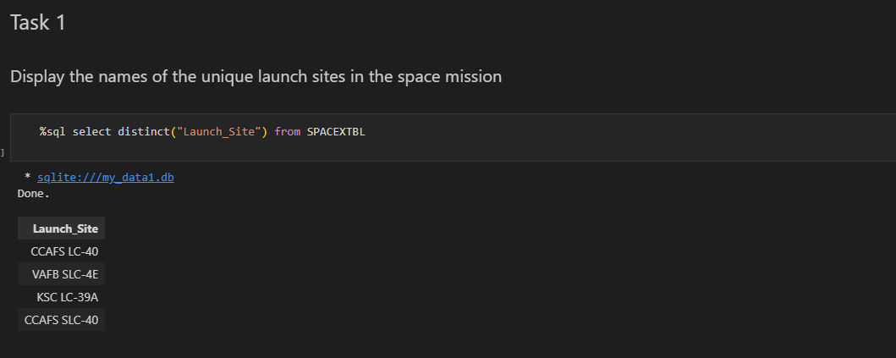
All Launch Site Names
Explanation
Used “distinct” to determine the unique site names

Slide 24
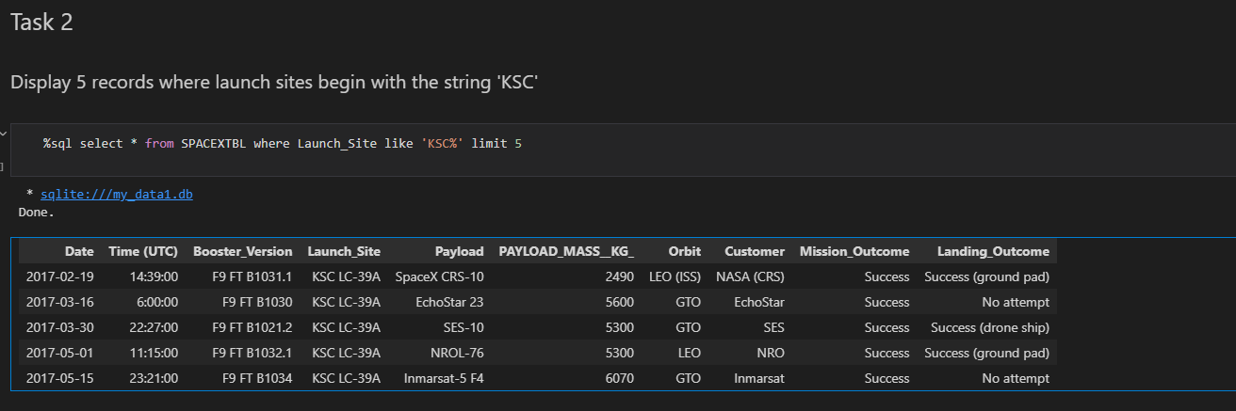
Launch Site Names Begin with 'KSC'
Explanation:
Used the query below.

Slide 25
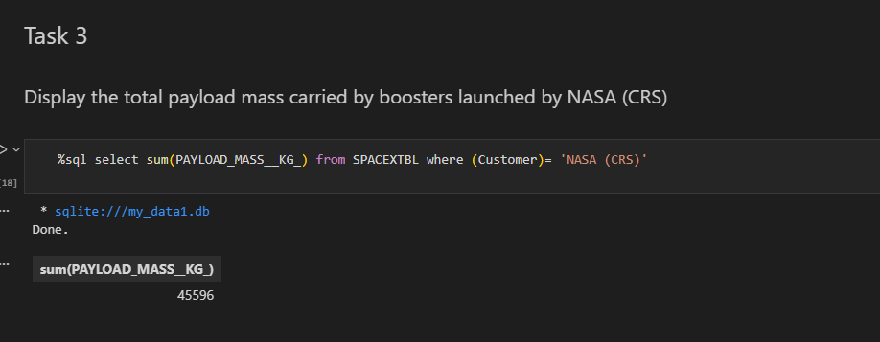
Total Payload Mass
Used the function below to calculate the total payload mass

Slide 26
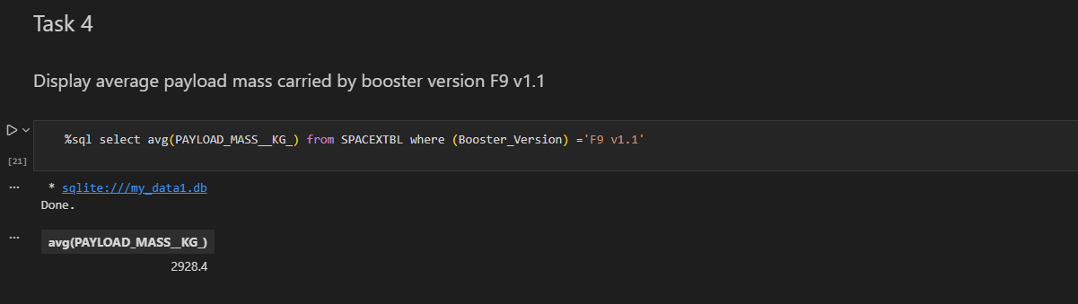
Average Payload Mass by F9 v1.1
The query below was used to calculate the average payload mass

Slide 27
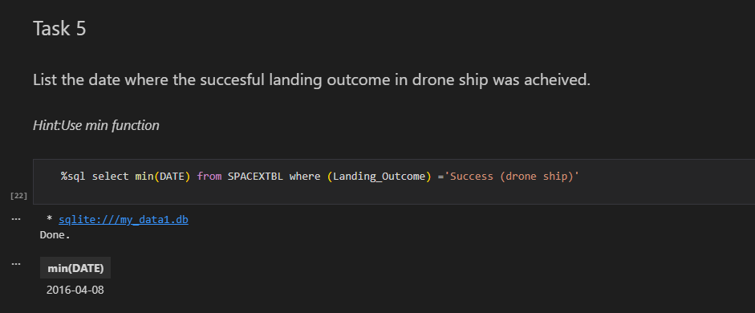
First Successful Ground Landing Date
Query below was used. The use of min function results in the earliest date where the landing outcome was a success

Slide 28
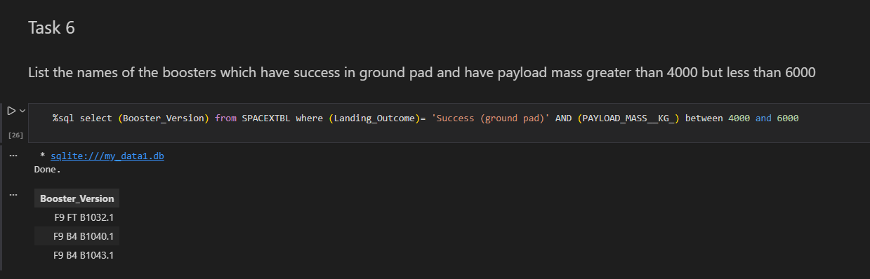
Successful Drone Ship Landing with Payload between 4000 and 6000
Query used is in below screenshot.

Slide 29
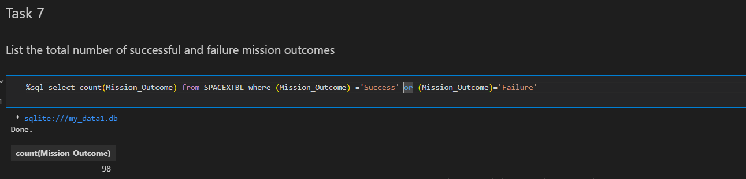
Total Number of Successful and Failure Mission Outcomes
Used the query below to determine the total number of mission outcomes

Slide 30
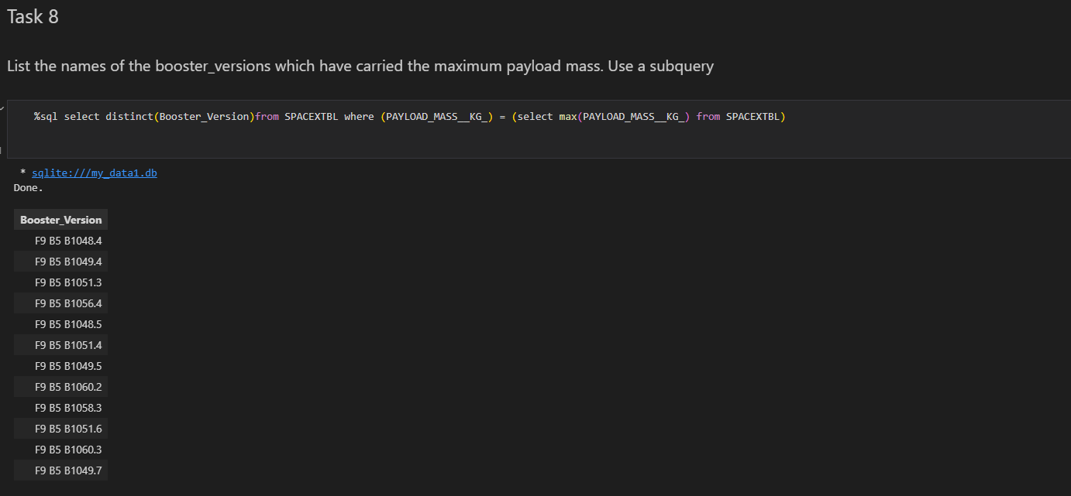
Boosters Carried Maximum Payload
Used a subquery to determine the maximum payload and then set the booster versions that carried that maximum

Slide 31
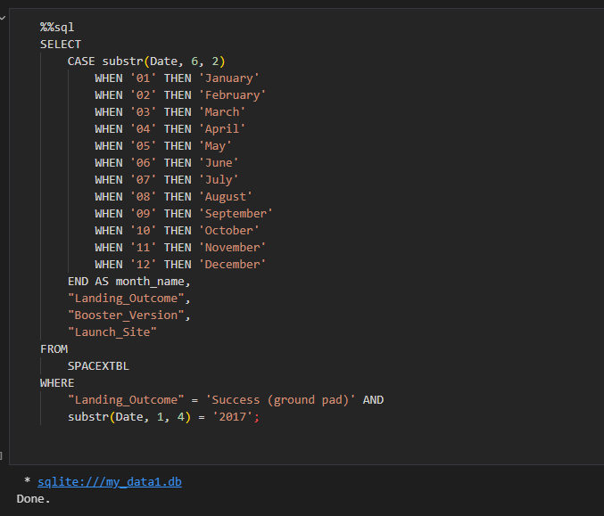
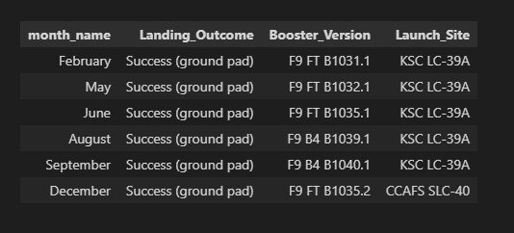
2017 Launch Records
Query and results in screenshot below. SQLLite at the time of running the code doesn’t support month names so use substr.

Slide 32
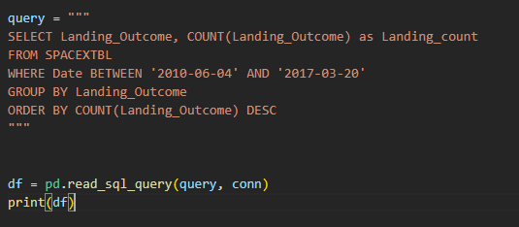
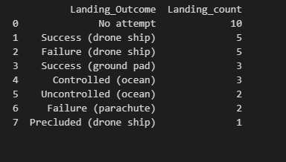
Rank Landing Outcomes Between 2010-06-04 and 2017-03-20
Query is ranking the count of landing outcomes (such as Failure (drone ship) or Success (ground pad)) between the date 2010-06-04 and 2017-03-20, in descending order

Slide 33

Section 3

Slide 34
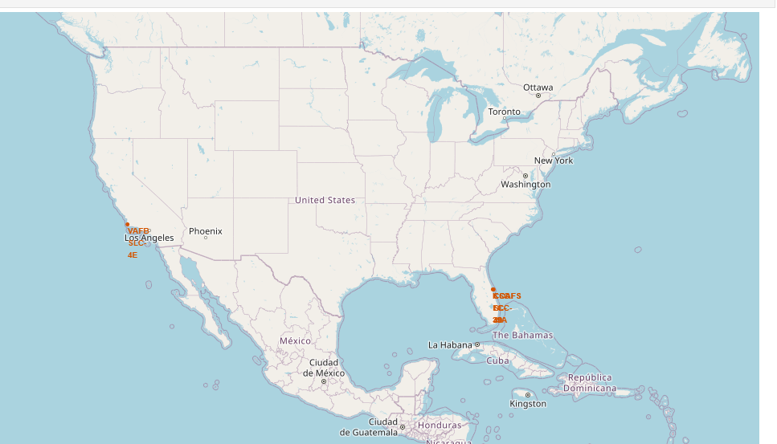
All launch sites’ location markers on a global map
The launch sites are in the United Sates along the coast in Florida and California.
The sites are not really close to the equator which has a latitude of 0.

Slide 35
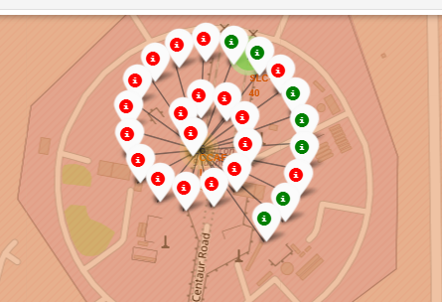
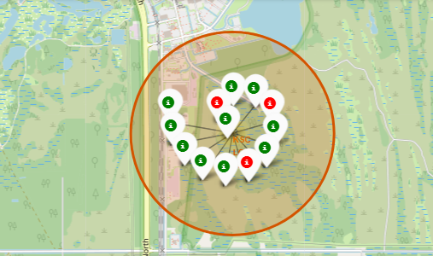
Color-labeled launch outcomes of sites
The color labeled markers show the success rates at the launch sites.
Green markers represents a successful launch; RED representing a failed launch.
Launch Site KSC LC-39A has a higher success rate.

Slide 36

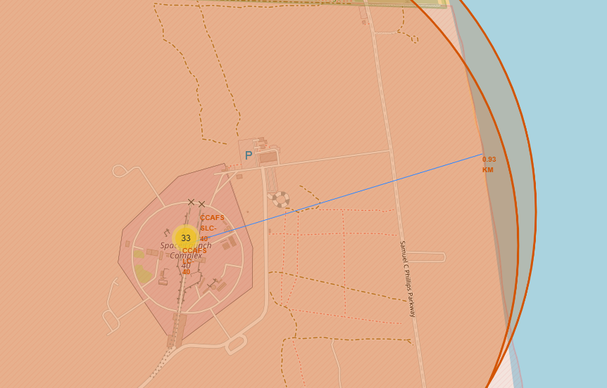
Launch site distance to coastline
The screenshot shows the distance to the coastline is about 0.9km

Slide 37

Section 4

Slide 38
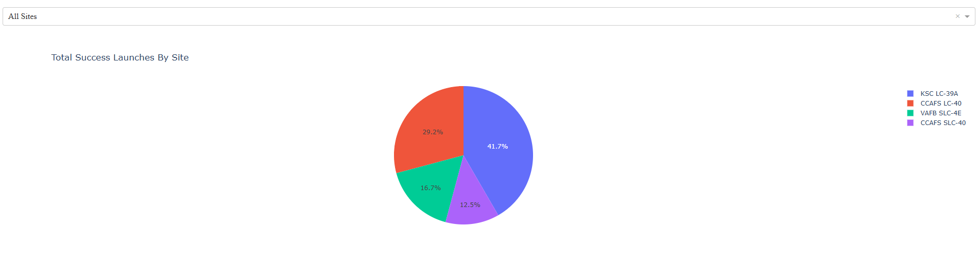
Launch Success for all Sites
This chart shows the success rate for all the sites

Slide 39
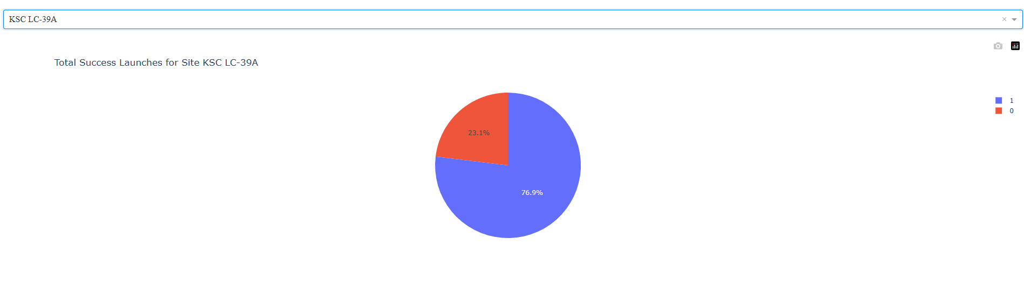
Piechart for the launch site with highest launch success ratio
KSC LC-39A has the most successful launches

Slide 40
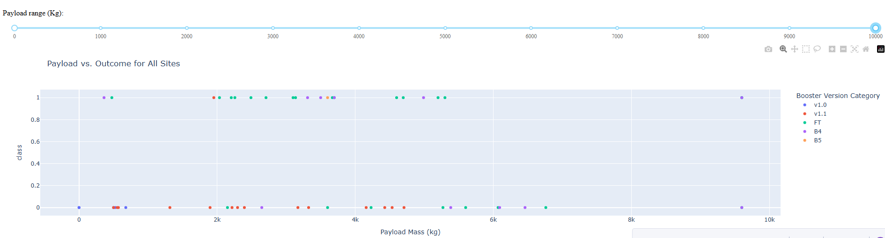
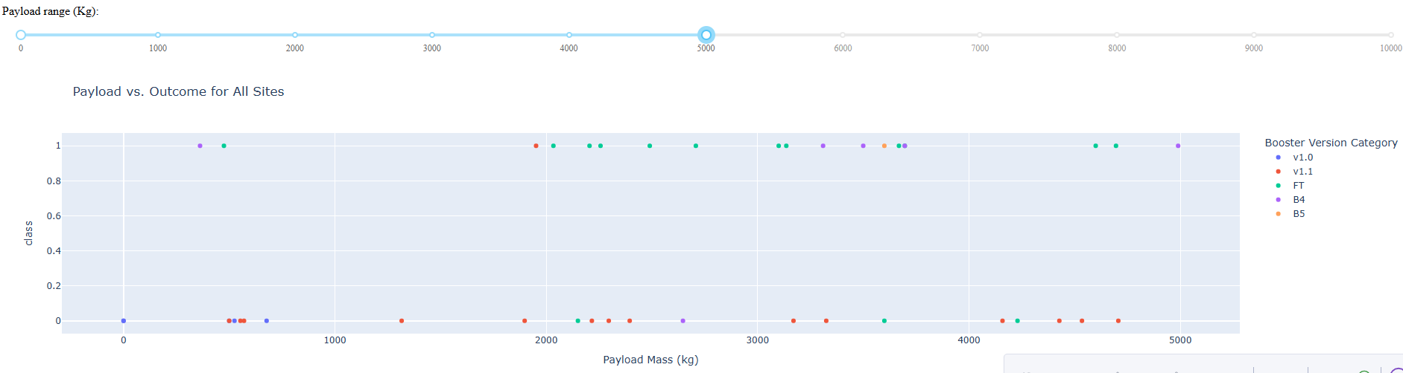
All sites Payload vs. Launch Outcome scatter plot, with different payload
The charts show the payload vs class at different payloads
Payloads between 2,000 and 6,000 have the most success rates

Slide 41

Section 5

Slide 42
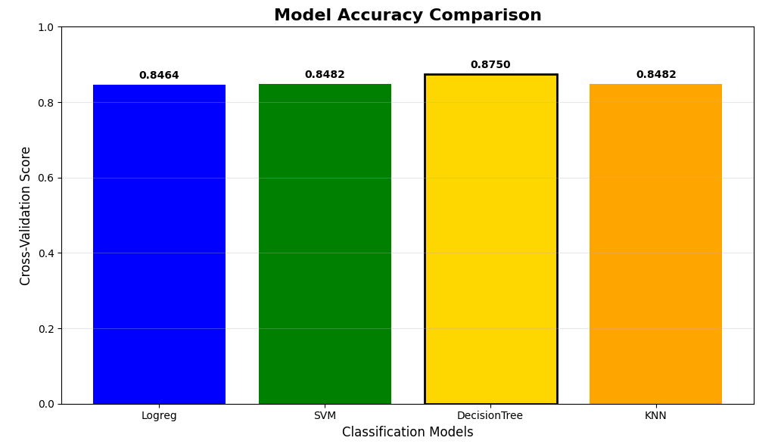
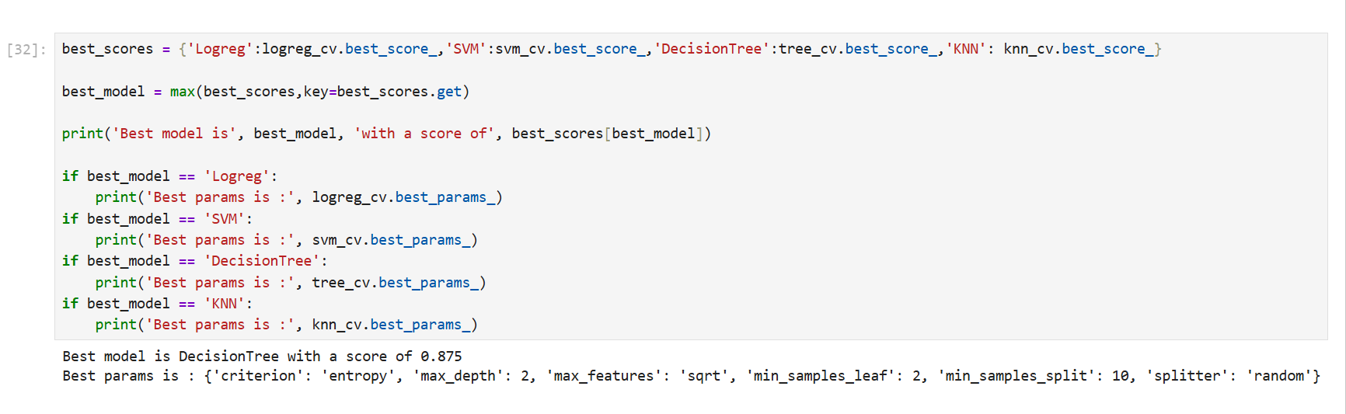
Classification Accuracy
The Decision tree has the highest classification accuracy

Slide 43
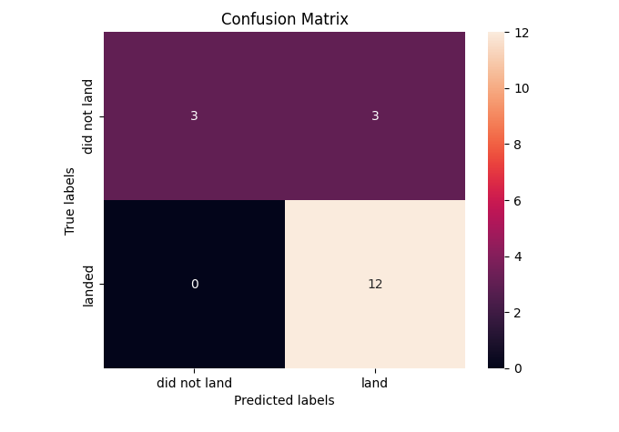
Confusion Matrix
The confusion for the decision tree can distinguish between the various classes, however there are still false positives

Slide 44
Conclusions
The Decision tree has the highest classification accuracy
Launches that had payloads between 2,000 and 6,000 had more success
The launch sites are mainly along the coast
KSC LC-39A has the most successful launches
The success rate increased over time

Slide 45


